Slide 1




Hi, that´s us!
Chris
Initiator
Andi
Develoment
Jakob
Design
Vadym
iOS Development

Slide 2
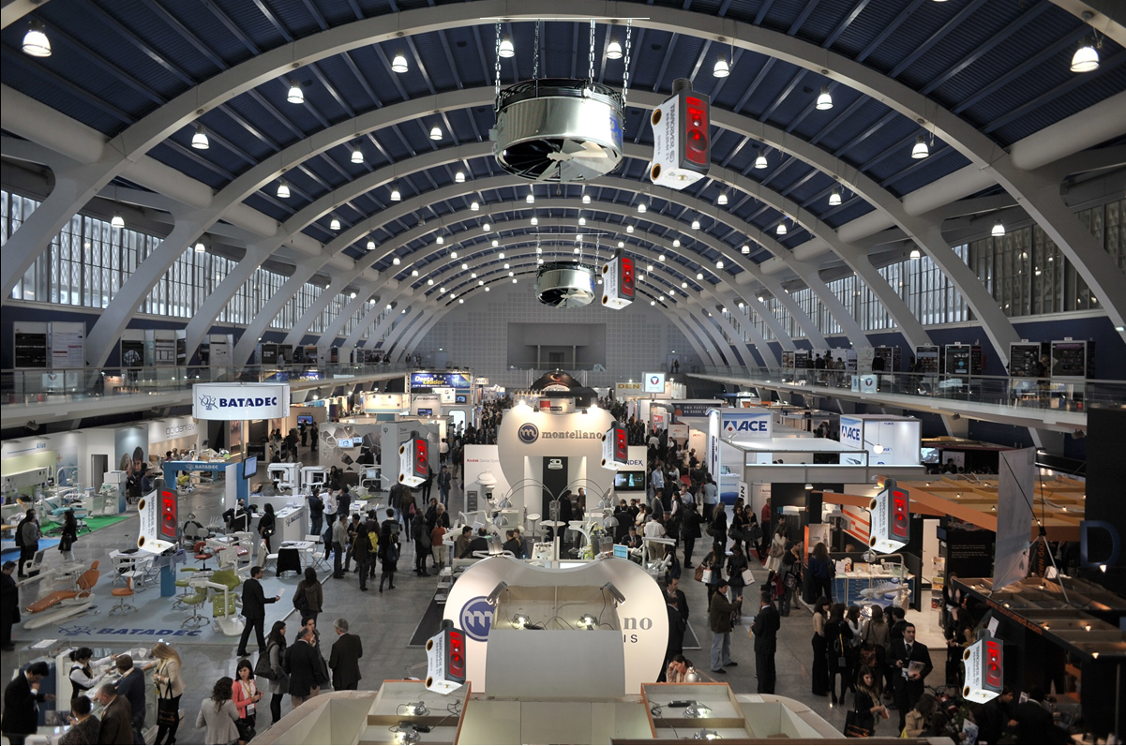
AirFräsher

Slide 3



AirFräsher is a smart 2D/3D sensor network build up on the latest IoT-Technology.
We measure temperature, humidity and air quality and visualize the data on heatmaps to identify spots of interest. AirFräsher autonomously takes action and controls countermeasures.
The modular design allows the development of custom solutions for individual situations. AirFräsher can be integrated into existing product infrastructures and raises EIoT to a new whole level.
It is based on fog computing and manageable through the cloud.
AirFräsher
01: Overview

Slide 4
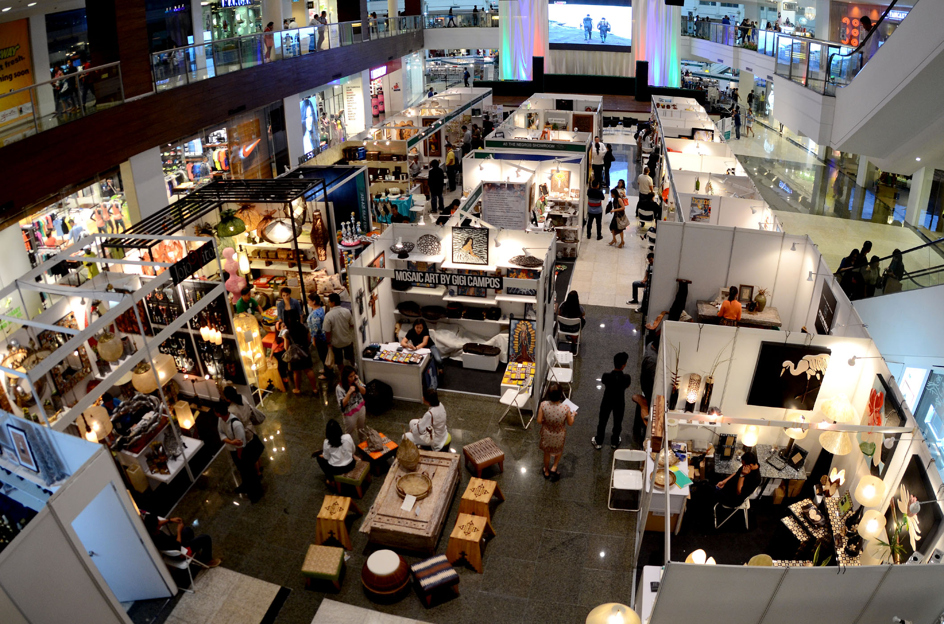
Usecase

Slide 5
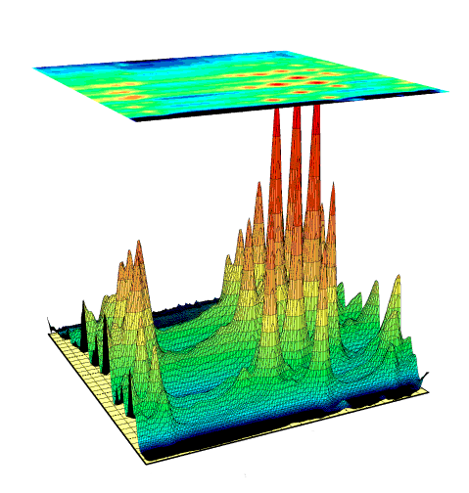
Visualize as heat map to identify spots of interest for the purpose of logging and also to control countermeasures.
Data will be collected over a long period of time and can then be analyzed. Alarms can be set optionally to be pushed to your smartphone, tablet or wearable, if the heat rise up or the air quality decreases.
By rearranging the booths, better allocations with smaller spots of inconvenience can be achieved.
AirFräsher
05: Scenario One

Slide 6
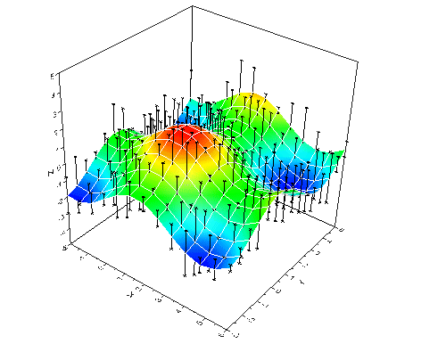
AirFräsher controls fans underneath the ceiling to push the warm air down to the floor level. Thus, we save heating coast and keep the humidity at a comfortable level by preventing cold and dry air to get in.
This scenario also applies to production and manufacture halls.
By measuring the air quality we also holds for cube farms.
AirFräsher
06: Scenario Two

Slide 7

Functionality/Implementation

Slide 8








Actuators
Air conditioner
A
Cisco Switch
Data analytics
Sensors
Fans
AirFräsher
07: Functionality

Slide 9



Do pioneer work and care for health
Save money by reducing heating costs
Promote sustainability and green footprint
v
WE
YOU
US
AirFräsher
08: Business model

Slide 10
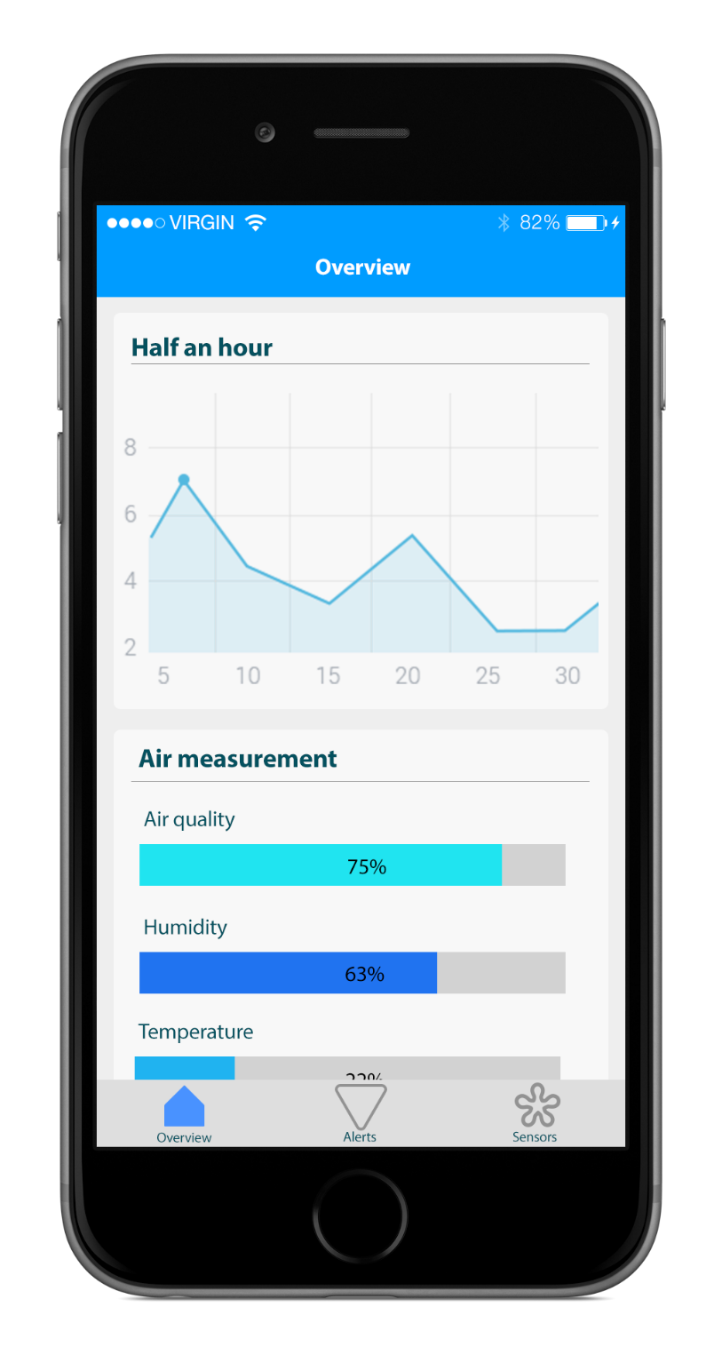
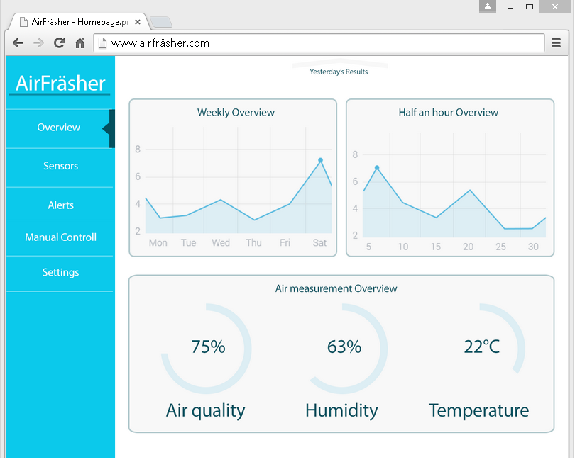
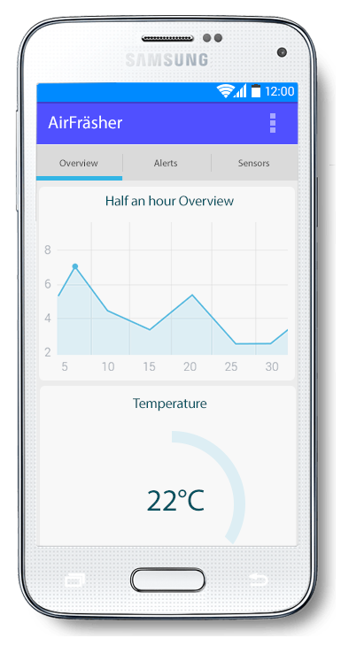
AirFräsher
09: Web & Apps

Slide 11
Thanks for your attention!
AirFräsher

Slide 13


Improving products
Save energy
Health and fitness
AirFräsher
02: Motivation

Slide 14

Limited functions
High maintenance and repair costs
Not IoT
Not Smart
Not XXX
US
AirFräsher
02: Current market

Slide 15
